Slide 1
C
H
S
analyzer
Visual Documentation
v1.0.3

Slide 2
User Interface

Slide 3
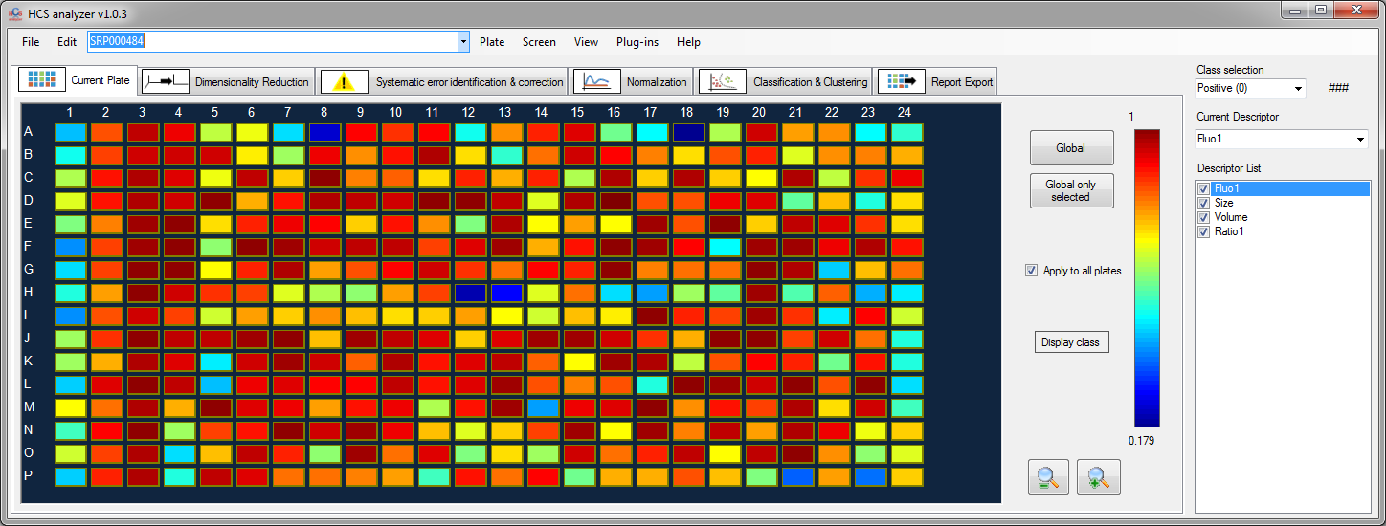
Active class
(for selection and some processes)

Slide 4
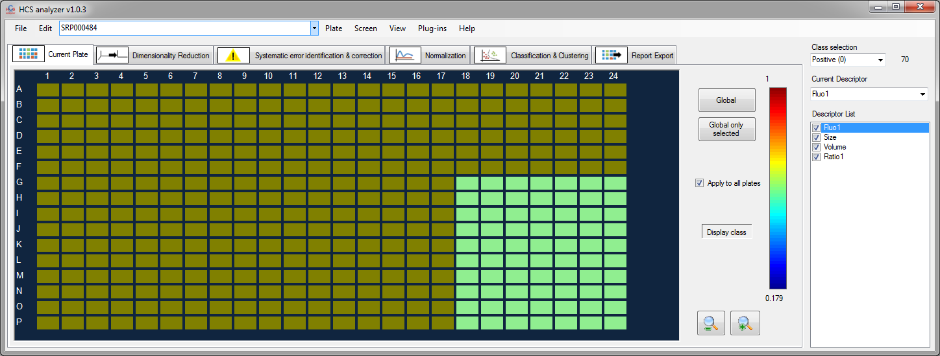
Number of wells associated with the active class
(current plate only)

Slide 5
Current activated plate

Slide 6
Process pipeline

Slide 7
Wells coordinate

Slide 8
Currently activated
descriptor

Slide 9
Current plate readouts display corresponding to the selected descriptor

Slide 10
Look up table
related to the current plate and the current descriptor

Slide 11
Available and activated descriptors
When inactivated, the descriptors will not be taken into account
for any process.

Slide 12
Zoom in and Zoom out
(can also be performed with the mouse wheel)

Slide 13
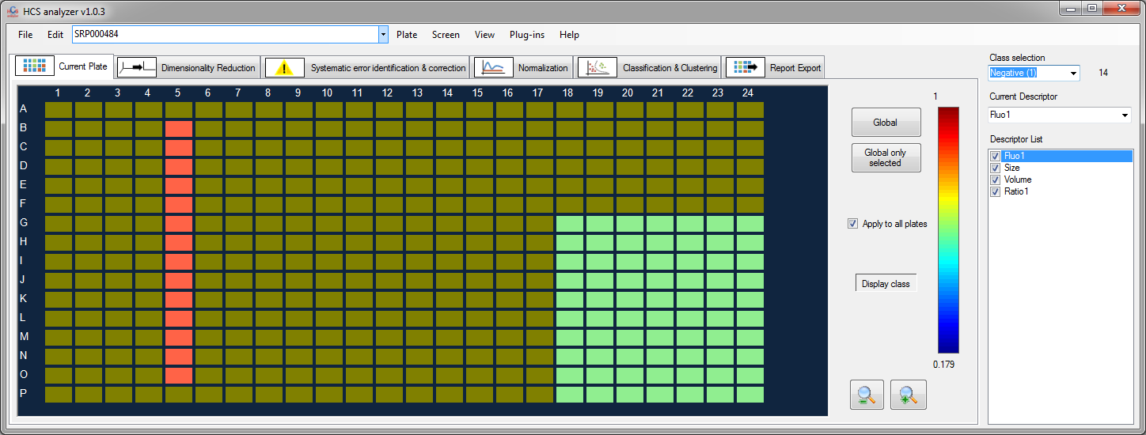
When activated
only class colors are displayed

Slide 14
When checked
class selection is performed on all the currently activated plates

Slide 15
When pressed, all the wells will turned into the currently selected class (including non activated wells)

Slide 16
When pressed, the wells will turned into the currently selected class (only activated wells are concerned)

Slide 17
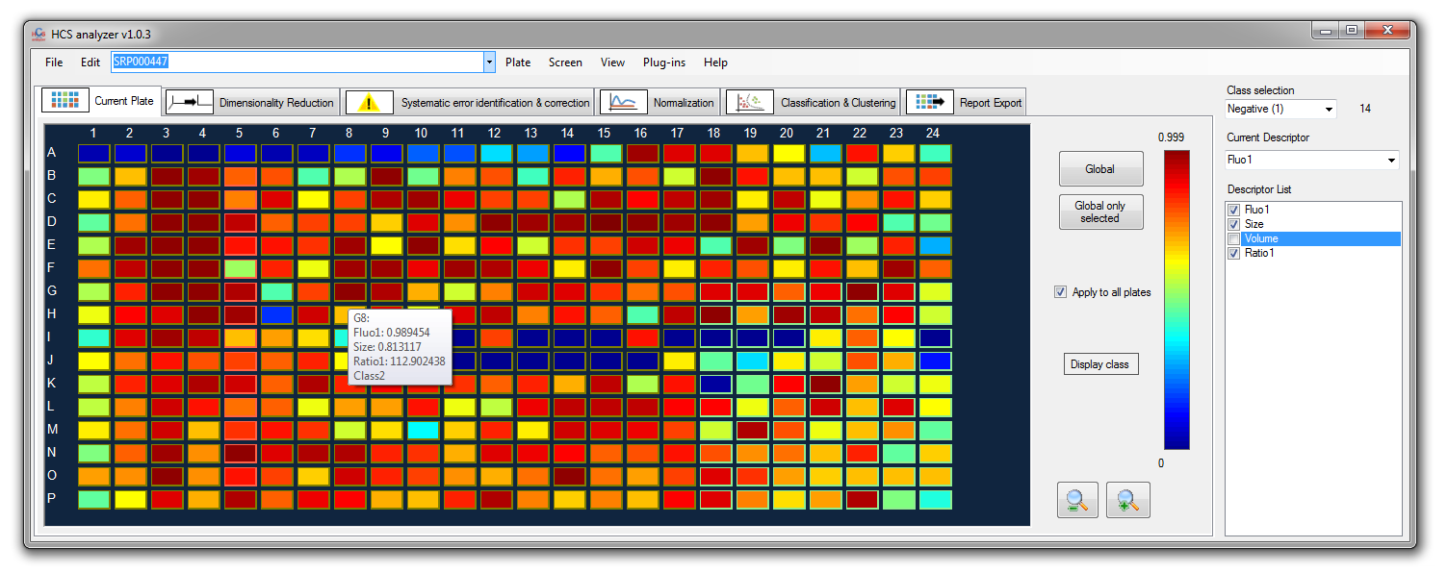
When the mouse cursor is
placed over a well, a list of information is displayed. This includes: Well position, name (if so), list of all the activated descriptors with their corresponding values and the class

Slide 18
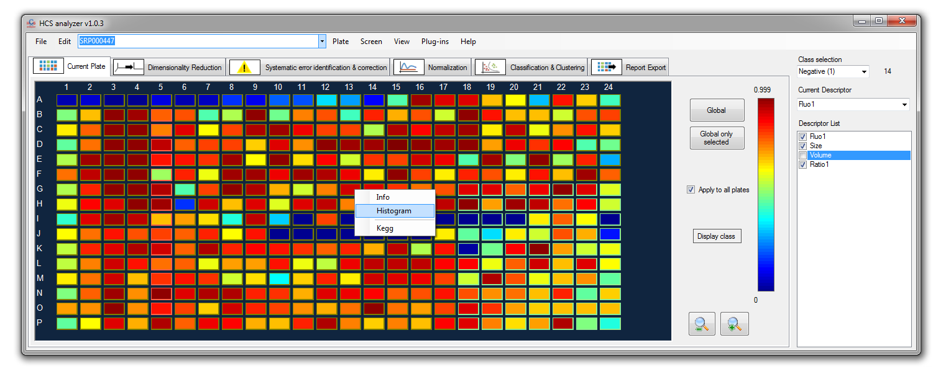
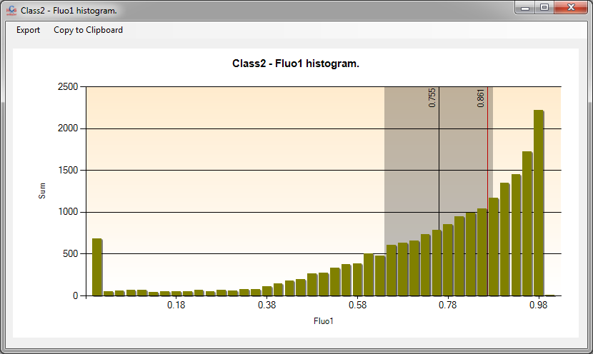
Contextual menu: Histogram
(right click on a well)
Average and standard
deviation of the displayed
histogram
Histogram of the selected histogram within the active class over the entire list of active plates.
(The histogram color is related to the class)
Current value of the selected well

Slide 19
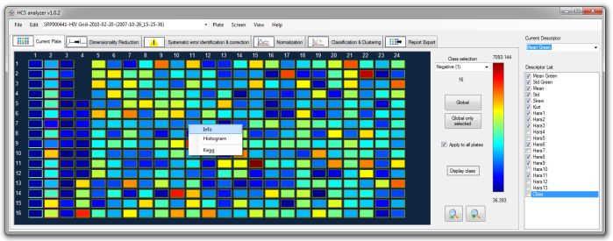
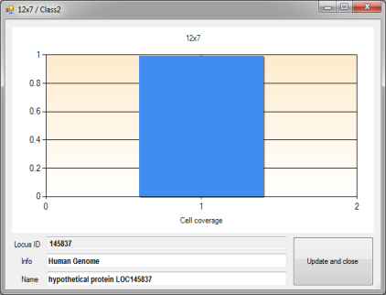
Contextual menu: Info (right click over a well)
Representation of the distribution (if available) of the current well selected descriptor
Display (if loaded) locus ID, information and Name associated to the current well (Info and Name are editable)
Save new Info and Name

Slide 20
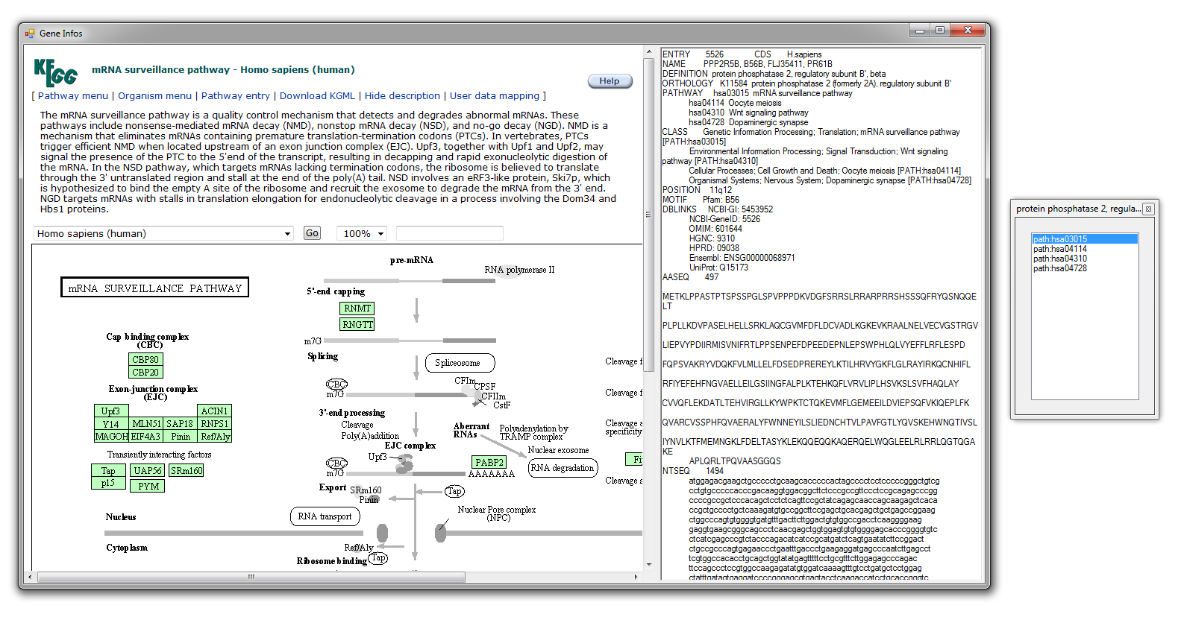
Contextual menu: Kegg (right click over a well)
Locus ID is required for this option
Current value of the selected well

Slide 21
Options

Slide 22
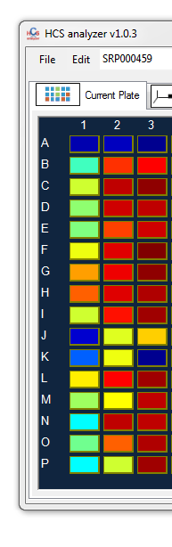
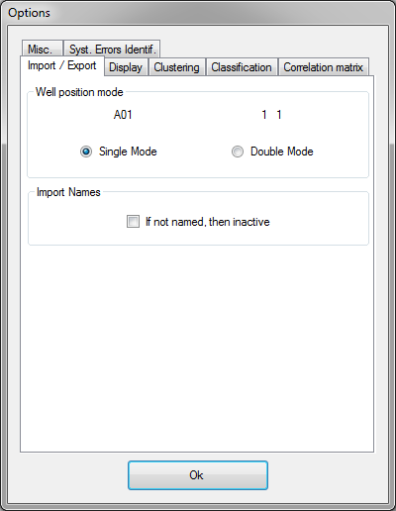
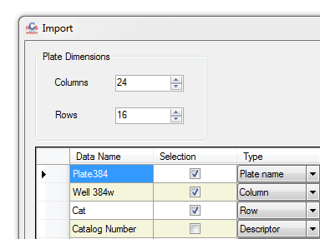
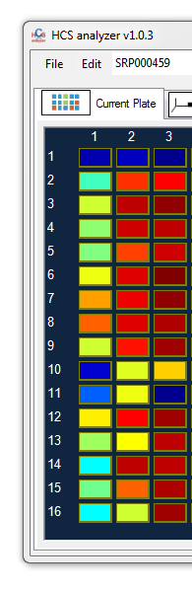
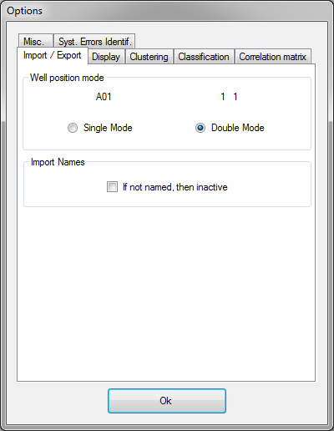
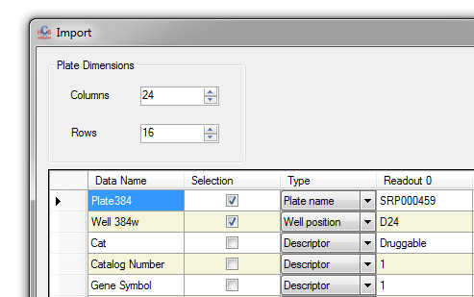

Slide 23
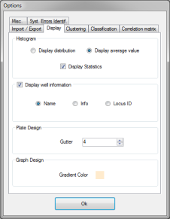
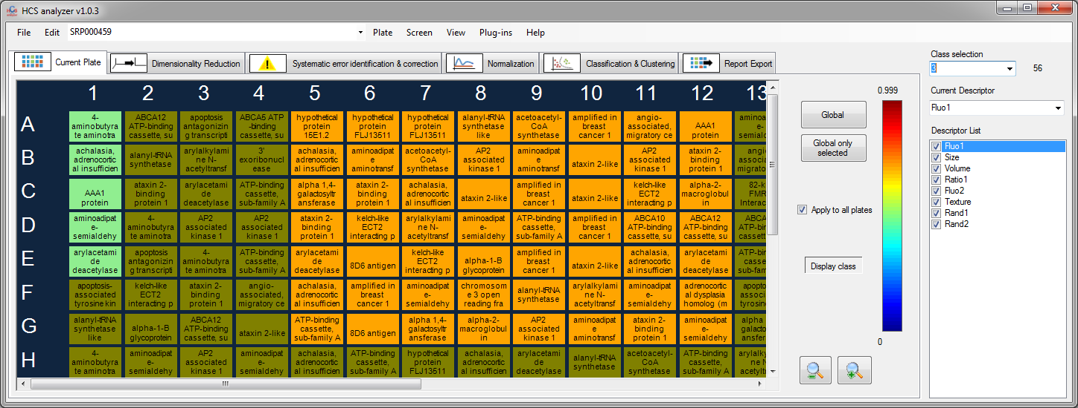

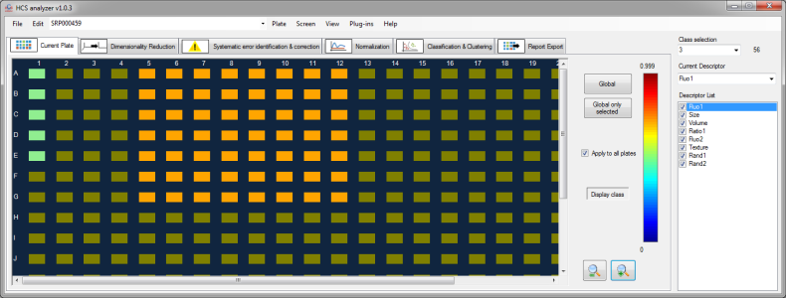
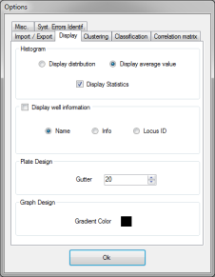
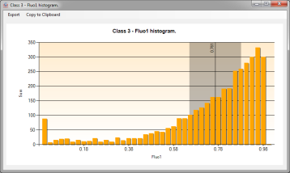
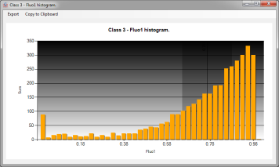

Slide 24
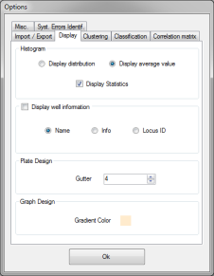
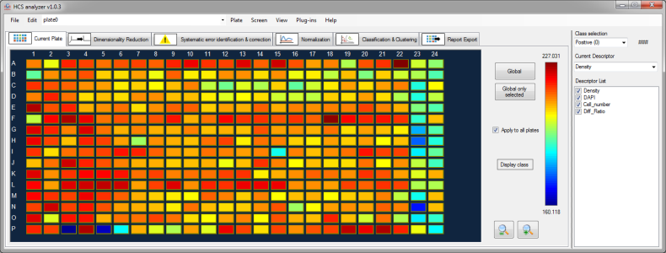
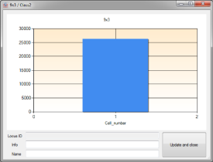
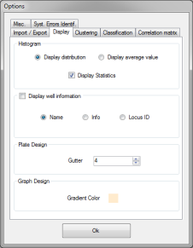
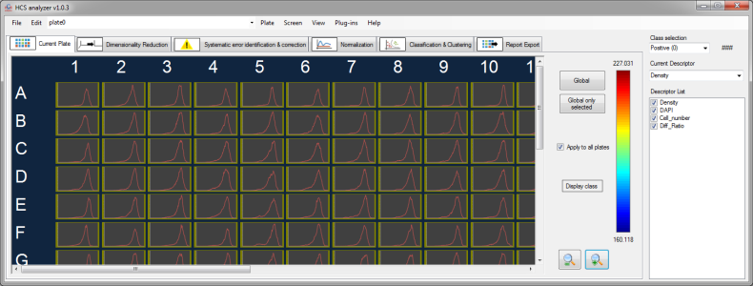
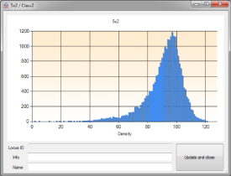
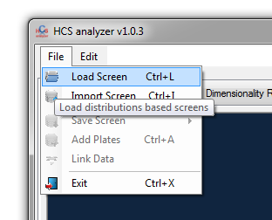
Note: display distribution option requires the have loaded a distributions based screen

Slide 25
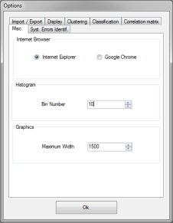
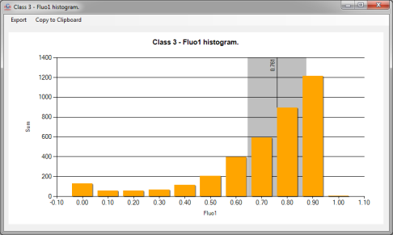

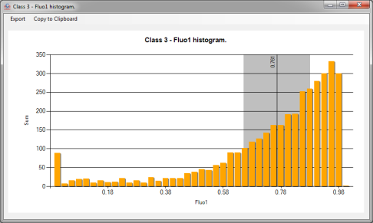

Slide 26
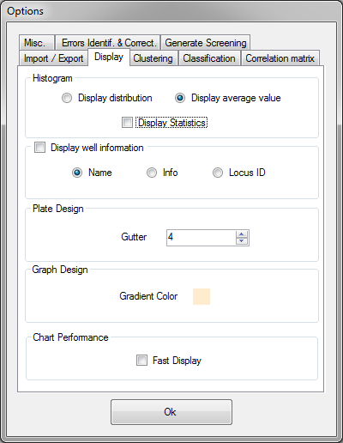
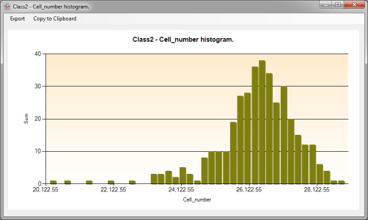
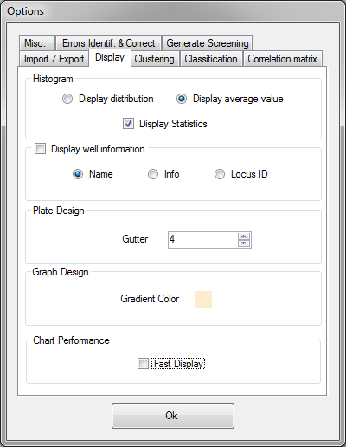
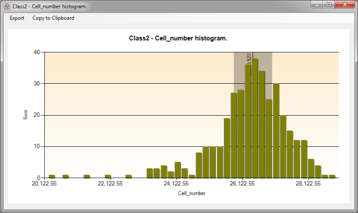

Slide 27

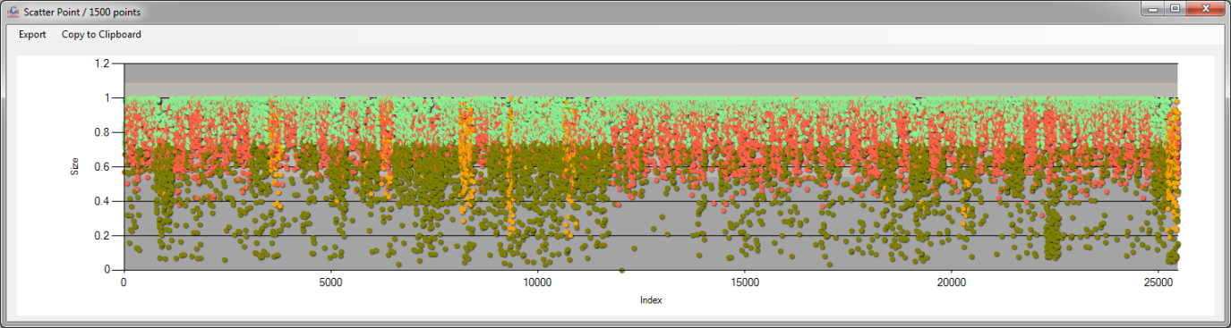

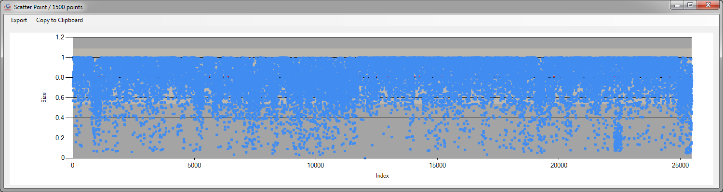

Slide 28
Importing Data

Slide 29
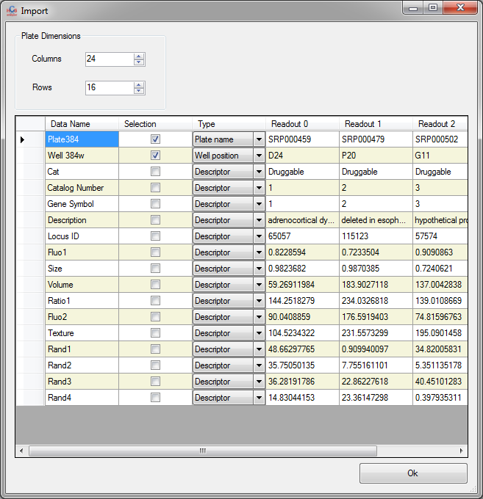

Slide 30
Plate dimensions

Slide 31
Readouts preview

Slide 32
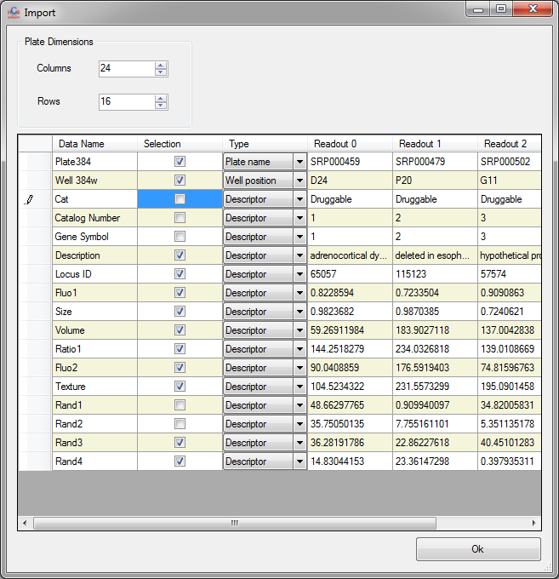
Names that be associated
with the data

Slide 33
If unchecked,
the corresponding data
will not be loaded

Slide 34
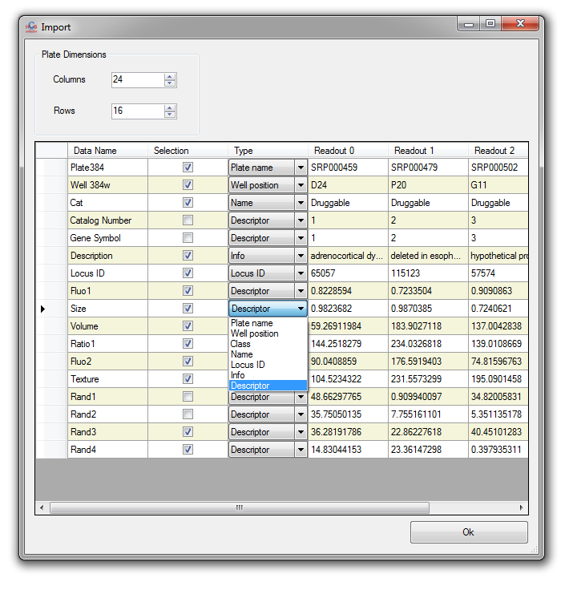
Data type.
Mandatory: Plate Name,
well position and at least
one descriptor.
Note: Locus ID should be
defined as an integer.

Slide 35
Generating artificial
univariate screening data

Slide 36
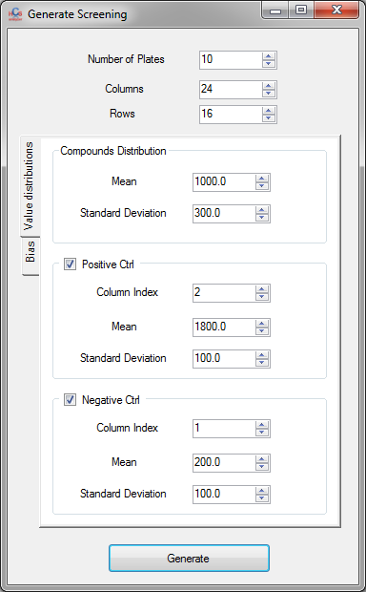
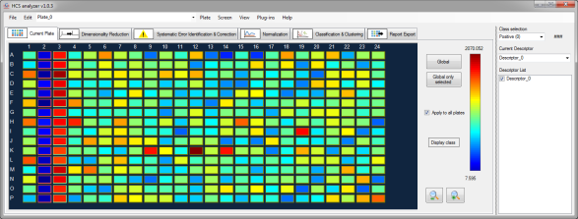

Slide 37


Slide 38
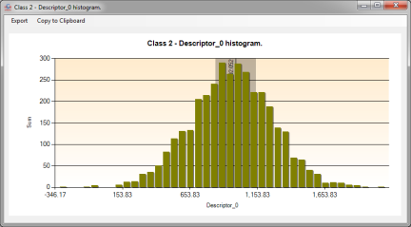
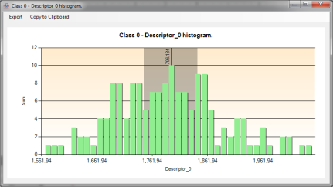
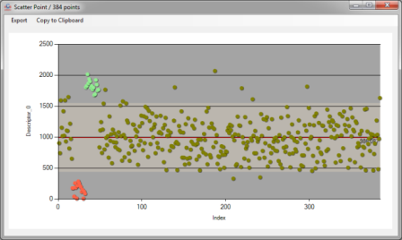
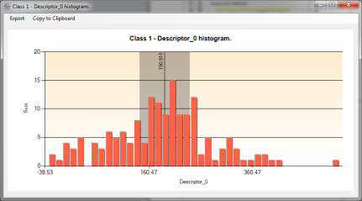

Slide 39
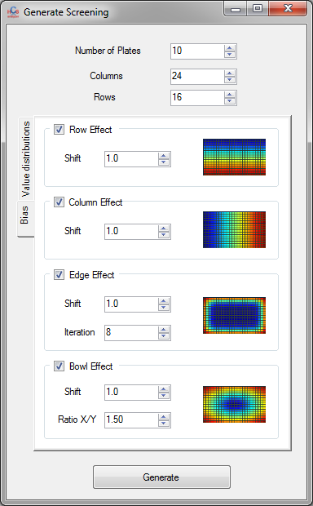
If an effect X is selected, it will be combined to original data by the following way:
Resulting Data = Original Data * (X + Shift_X)

Slide 40

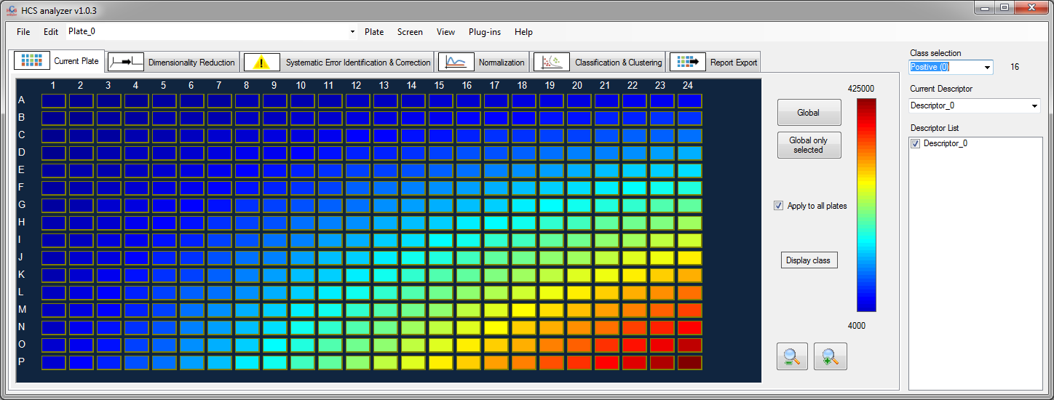

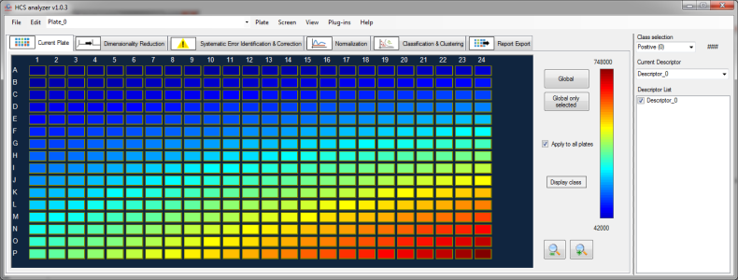
The higher Shift_X is, the lower X contribution to the generated data

Slide 41
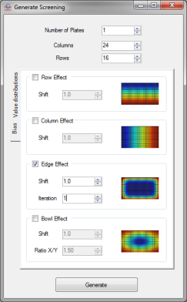




Slide 42





Slide 43







If a parameter X is checked, its value will
vary from, increasing with a step
defined in the options window.

Slide 44
Generating artificial
multivariate screening data

Slide 45



Slide 46
The dimension corresponds
to the number of descriptors

Slide 47


Up to 10 different clouds can
be generated

Slide 48
Their positions within the plate are defined by
column

Slide 49


Each cloud (phenotype) is modeled by a Gaussian distribution defined by its means in every dimension

Slide 50
As well as its variances.

Slide 51
Dimensionality reduction

Slide 52

Information windows:
provide feedback about the process as well as information and useful links

Slide 53
Desired new dimension

Slide 54
Feature selection approaches:
Unsupervised: use all the activated wells of the activated plates to reduce the dimension
Supervised: keep the descriptors required to
cluster the classes (but the neutral class)

Slide 55

Perform the dimensionality reduction
The descriptors selection
is then automatically adjusted

Slide 56
Quality controls

Slide 57




Display the sorted Z-factors of the current plate for each selected descriptor
Display the sorted Z-factors of the selected descriptor for all the active plates

Slide 58

Display the normal probability plot
of the current selected descriptor values
among the set of points of the
selected class.
Note: operate the same way
for the entire screen.

Slide 59




Display the correlation
matrix of the active descriptors
And the ranked corresponding histogram (optional)

Slide 60

Identify the potential
systematic errors for
each selected plates on each active descriptor

Slide 61



Double click
on a row
display the corresponding
readouts
Systematic errors identification parameters can be changed by the options window

Slide 62




Plate by plate, and descriptor by descriptor, correction procedure
can be performed using the dedicated function

Slide 63



Plates can be rejected
regarding a chosen parameter
(here Z-factor on the current descriptor)
before
after

Slide 64



Evolution (average and standard deviation)
of the current descriptor
within a defined class
can be monitored to identify
abnormalities

Slide 65
Normalization

Slide 66



Various approaches
for data normalization
of the screening data
are available
(controls based or not)
before
after

Slide 67
Clustering and classification

Slide 68



The user has to define the desired
cluster number.
before
after

Slide 69



Some clustering methods
allow automated evaluation of the optimum number of clusters.
Note: if more than 10 classes are detected, the clustering is not operated.
Original
readouts
Clustering (here:
3 classes have identified)

Slide 70



This class will not be used for the learning, but will be classified.
The user has to define the classes for the training.
Plate by plate: the training step is performed on the each plate independently.

Slide 71


If the classification operated is tree based (C4.5) a tree diagram is affected for each plate.

Slide 72
Hierarchical Tree visualization

Slide 73


Class color
Well position
Note: this operation can be time consuming for large number of data

Slide 74





Slide 75
Pathways analysis

Slide 76



Locus IDs have to be associated to each well
Note: this operation requires internet connection
Recurrence of each specific pathway

Slide 77
Export

Slide 78


At this stage, names can be modified
Descriptors are checked regarding the selection
but can be modified for the export purpose

Slide 79





Slide 80



Slide 81



Slide 82


Slide 83



Weka
HCS Analyzer

Slide 84
Core Development

Slide 85


Unpack and launch the solution

Slide 86


Look, develop, modify, debug, test
Launch and have fun

Slide 87
Plugins Development

Slide 88


Add a new HCSAnalyzer Plugin project within the global solution
Note: this template is available on our website, and has to be copied in your dedicated visual studio directory

Slide 89


Add the two following references to your project

Slide 90


Add your HCS Analyzer plugins directory in the
Post-build event command line

Slide 91


Add information about your plugin
(menu, etc.)
Develop your plugin and do not forget to share it

